Slide 1
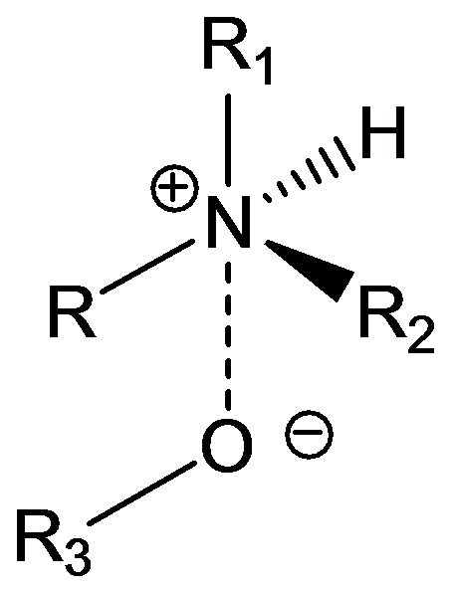
Drug-Receptor Bonding
Ionic : the strongest type of non-covalent bond. This results from the attraction of ions with opposite charges.

Slide 3
Ion-Dipole : results when there is an attraction between an ion and the partial charge of a dipole of the opposite polarity.

Slide 4
Dipole-Dipole : Here a partially positive atom in a dipole is attracted to a partially negative atom in another dipole.
Hydrogen Bonding: A dipole-dipole interaction where on of the constituents is a hydrogen attached to a heteroatom.

Slide 5
Hydrogen bonds
Vary in strength
Weaker than electrostatic interactions but stronger than van der Waals interactions.
A hydrogen bond takes place between an electron deficient hydrogen and an electron rich heteroatom (N or O).
The electron deficient hydrogen is usually attached to a heteroatom (O or N).
The electron deficient hydrogen is called a hydrogen bond donor (HBD).
The electron rich heteroatom is called a hydrogen bond acceptor (HBA).

Slide 6
Hydrogen bonds
The interaction involves orbitals and is directional.
Optimum orientation is where the X-H bond points directly to the lone pair on Y such that the angle. between X, H and Y is 180º.
HBD
HBA

Slide 7
Hydrogen bonds
Examples of strong hydrogen bond acceptors
  - carboxylate ion, phosphate ion, tertiary amine.
Examples of moderate hydrogen bond acceptors
  - carboxylic acid, amide oxygen, ketone, ester, ether, alcohol.
Examples of poor hydrogen bond acceptors
  - sulfur, fluorine, chlorine, aromatic ring, amide nitrogen, aromatic amine.
Example of good hydrogen bond donors
  - Quaternary ammonium ion.

Slide 8
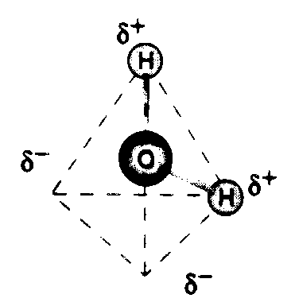

Slide 9
Water can act as an H-bond Donor or Acceptor
Donates H
Accepts H
Lone pair electrons

Slide 10
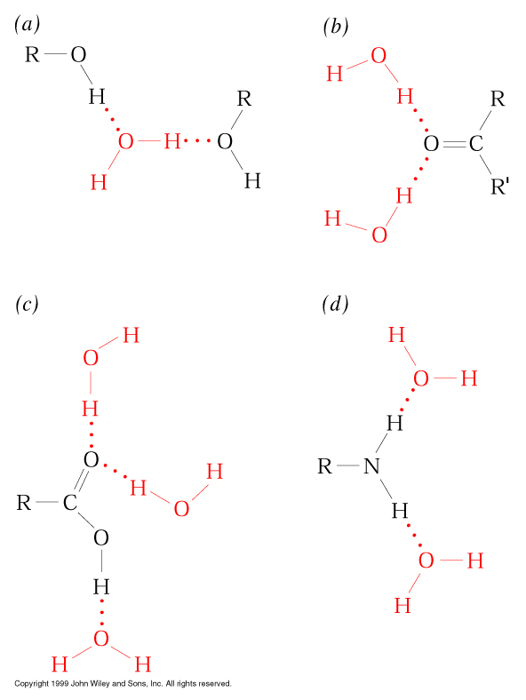
Examples of
H-bonding
interactions

Slide 11
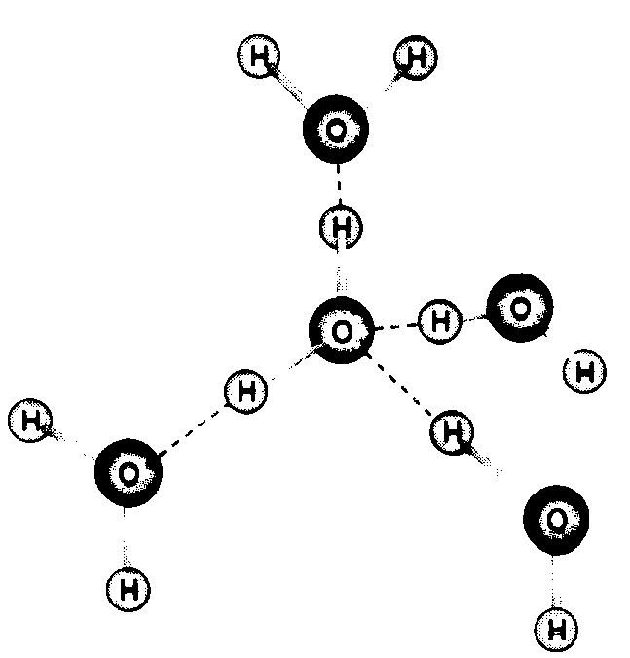

Slide 12
The Hydrophobic Effect : when two alkyl chains approach one another, water is extruded from the space in between them, resulting in an increase in entropy, and thus a decrease in energy.

Slide 13
Charge-Transfer Complexes : a lone pair of electrons is "shared" with a neighboring group that has considerable π character.

Slide 14
Van der Waals Forces : one carbon in a chain approaches another carbon on a neighboring chain, causing a perturbation known as an induced dipole. These opposite partial charges then attract one another.

Slide 15
Drugs may also bind to receptors using covalent bonding. This may be a permanent bond, in which case the receptor or enzyme target is "killed", or it may be transient.

Slide 16
Drug Interaction with Receptor
Lock & Key Model
NT binds to receptor
  NT = key
  Receptor = lock
NT
Receptor A

Slide 17
NT
Receptor A

Slide 18
NT
Receptor A
Receptor B

Slide 19
NT
NT
Drug A
Drug B
Receptor A
Receptor B

Slide 21
α-Adrenoceptor
H-Bonding
region
H-Bonding
region
Ionic
bonding
region
Van der Waals
bonding region
H-Bonding
region

Slide 22
α-Adrenoceptor
ADRENALINE

Slide 23
β-Adrenoceptor
ADRENALINE

Slide 24
β-Adrenoceptor
SALBUTAMOL

Slide 25
α-Adrenoceptor
SALBUTAMOL

Slide 26
α-Adrenoceptor
SALBUTAMOL

